Slide 1
Case Studies
Innovative technologies for climate change mitigation by Mediterranean agricultural sector– Clima MED
LIFE17 CCM/GR/000087
https://life-climamed.eu/home

Slide 2
Management of agricultural soils for greenhouse gas mitigation: Learning from a case study in NE Spain
Sánchez B., Iglesias A., Mcvittie A., Álvaro-fuentes J., Ingram J., Mills J., Lesschen JP., Kuikman PJ.

Slide 3
Introduction
This study focuses on evaluating the practices that contribute to the GHG mitigation targets and also have clear benefit to soil organic carbon (SOC) content, in both agronomic and socioeconomic perspective.
Three important questions addressed in this research are:
Are they cost-effective for farmers?
Do they reduce GHG emissions?
What policies favour their implementation?

Slide 4
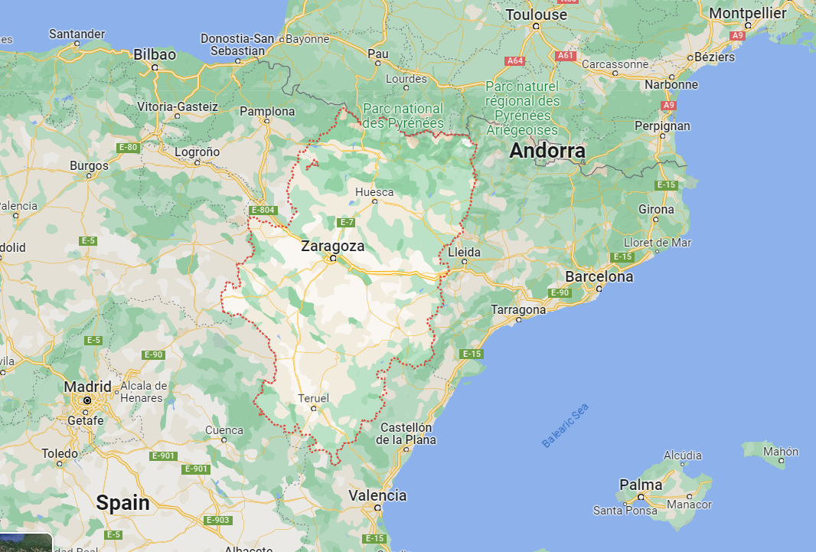
Study Area
The study was conducted in Aragon region in NorthEast Spain (47.000km2)
The area represents the semiarid conditions of Mediterranean agricultural systems
The study area includes 89% rainfed crops and 11% irrigated crops
Conventional soil tillage and crop residue removal led to soil degradation

Slide 5
Abatement potential and costs
The annual abatement potential in the NE Spanish region could reach 1.34 MtCO2e by the complete adoption of the practices which represents 73% of emissions released by crop production in the region.
Mitigation practices that generate Negative Abatement Cost
Minimum tillage
Animal manure fertilization
Cover crops in field crops
Optimized fertilization
The inclusion of legumes in rotations
Mitigation practices that Generate Positive Abatement Cost
Cover crops in vineyards and olives,
Cover crops in almonds
Residue management

Slide 6
Abatement potential and costs
Mitigation practices that generate Negative Abatement Cost | Abatement Potential (MtCO²e ) | Cost (€/tCO²e ha-1yr-1)
Minimum tillage | 0.2 | -1,168 to -807
Animal manure fertilization | 0.01 (Maize) 0.009 (Barley) | -905 -416 to -177
Cover crops in field crops | 0.03 | -650 to -400
Optimized fertilization | 0.3 | -94
The inclusion of legumes in rotations | 0.46 | -343
Mitigation practices that generate Positive Abatement Cost
Cover crops in vineyards and olives, | 0.07 | 50
Cover crops in almonds | 0.06 | 238
Residue management | 0.12

Slide 7
Abatement Potential of Mitigation Measures (-)
Minimum Tillage
Proven to have the potential for increasing Soil Organic Carbon (SOC)
Minimum tillage has less fuel and time requirements compared to conventional
The initial cost of a direct seed-drill and the additional need of spraying might cause low acceptance by farmers
Manure Application
Manure has the potential to replace nitrogen fertilizers application, at a lower cost
The use of animal manures is proven to enhance carbon return to the soil
Policies, cost and availability of manure are some of the barriers preventing the extend use of the practice

Slide 8
Abatement Potential of Mitigation Measures (-)
Cover crops in field crops
Winter cover crops have the potential to reduce N leaching and increase nitrogen use efficiency
Optimized fertilization application
Adjusting the application rates and using precise fertigation techniques can reduce N2O emissions
Initial infrastructure cost, soil analysis cost and lack of skills are the main barriers of the technique

Slide 9
Abatement Potential of Legumes in Rotation (-)
Cover crops have the benefit of increasing grain yield and improving soil quality and biodiversity
Implementing legume-based rotations in semiarid regions may have a positive impact on the SOC pool
The use of legumes (e.g., vetch, pea) and cruciferous crops (e.g., rapeseed) in rotation with winter cereals (e.g., barley, wheat) is a common practice in Mediterranean environments
High cost of weed control, difficulties in selling legumes and import competition are the main constraints

Slide 10
Abatement Potential of Mitigation (+)
Cover crops in rainfed vineyards and olives
Cover crops have the potential of SOC gains and erosion control in semiarid regions. In the long-term they can make the system profitable
In almonds, the maintenance of cover crops by mowing instead of repeated disking can be less costly, reduce insect and mite problems, cause less soil compaction, increase water penetration, and require less management time
Farmers are skeptical in adopting these practices due to the possible competition for water and nutrients.
Residue Management
Residue management in barley and wheat could provide abatement of about 0.12MtCO2e at higher positive cost. Higher costs are mainly due to loss of revenue from selling straw for animal feed as a by-product. Incorporating residues from crops into the soil, may also enhance carbon returns and SOC sequestration

Slide 11
Conclusion
The research offers a comprehensive interdisciplinary examination of the connections between mitigating climate change and the economic aspects of sustainable farm management
Even when cost effectiveness and abatement are optimal, agronomic and social factors are probable to create a barrier in implementing sustainable practices
Policy interventions and provision of training and advisory services to farmers can improve farmers skills
Capital grants and subsidies can fulfill farmers equipment needs
Farmers established traditions of agricultural production, market conditions and poor availability of resources cannot be controlled by policies implementation
More cost-effective reduction of GHGs can be attained by focusing on nutrient management and methane reduction (enteric fermentation) measures

Slide 12
Reduced tillage as an alternative to no-tillage under Mediterranean conditions: A case study
R. Lopez-Garrido, E. Madejo´n, M. Leo´ n-Camacho, I. Giro´n, F. Moreno, J.M. Murillo

Slide 13
Introduction
Objective of the research
To compare the crop development and physical, chemical, and biochemical properties in soils under different tillage systems:
Traditional Tillage (TT),
Reduced Tillage (RT) and
No-tillage (NT),

Slide 14
Study Area
Sevilla, Spain –
Soil: Sandy clay loam soil, Enrtisol
Climate is typically Mediterranean, with mild rainy winters (484 mm mean annual rainfall) and very hot, dry summers
Three different tillage treatments were established
- Traditional tillage (TT): mouldboard ploughing (ca. 25–30 cm deep) and two chisel operations at 25 cm depth, followed by a disc harrowing of 12 cm depth
- Reduced Tillage (RT): only one chisel operation at 25 cm depth followed by a disc harrowing of 5 cm depth
- No-tillage (NT): spraying the plot with pre-emergence herbicides and leaving the crop residues on the surface (only direct drilling)

Slide 15
Soil Organic Carbon content
SOC accumulation at 0–25 cm depth was greater under both conservation tillage systems (RT and NT) compared to traditional system
NT treatment significantly increased the SOC content at surface (by ca. 20%) with an opposite tendency at depth (10–25 cm)

Slide 16
Soil physical properties and plant response
Emergence, plant height and yield were similar in RT and TT or even slightly greater in RT
Contrastingly, yield, grain weight, plant density and height were extremely low making it prohibitive for the farmer

Slide 17
Conclusion
NT improved soil quality in relation to chemical and biochemical properties, but impacted the soil physical properties and penetration resistance. Subsequently, the crop productivity and seed quality were greatly affected
RT is the best option to maintain crop performance, while improving soil properties and sequestrating soil carbon. Crop response under RT was significantly improved and seed quality was slightly better than TT
Farmers need to be encouraged in using less invasive techniques in the environment. To achieve that is important to introduce a justifiable and flexible land management

Slide 18
Impact of alley cropping agroforestry on stocks, forms and spatial distribution of soil organic carbon — A case study in a
Mediterranean context
Rémi Cardinael,Tiphaine Chevallier, Bernard G. Barthès, Nicolas P.A. Saby, Théophile Parent, Christian Dupraz, Martial Bernoux, Claire Chenu

Slide 19
Introduction
This study aim to assess the effect of introducing rows of timber trees into arable land on SOC storage
The hypothesis is that SOC stocks would be higher in the agroforestry plot compared to the control plot, also at depth, and that SOC stocks would decrease with increasing distance to the trees at all depths.

Slide 20
Study Area
Prades-le-Lez, 15 km North of Montpellier, France
Climate is sub-humid Mediterranean with an average temperature of 15. 4°C and an average annual rainfall of 873 mm
Tree element: hybrid walnuts (Juglans regia × nigra cv. NG23) at a density of 110 trees/ha
The cultivated inter-row was 11 m wide
Annual crop: Mostly durum wheat

Slide 21
Soil Organic Carbon Concentration
Soil depth and location, i.e., tree row vs. inter-row, were the only variables affecting significantly SOC concentrations
Distance to the closest tree had no significant effect
At a depth of 0–10 cm, SOC concentration doubled in the tree row compared to the inter-row and to the control
SOC concentration was significantly higher in the tree row than in the control plot to 120 cm soil depth and the inter-row to 30 cm soil depth

Slide 22
Soil Organic Carbon Stocks
(as a function of soil depth, location and distance to the closest tree)
There is a proven variability of SOC stocks depending on the depth and given distance from the closest tree
SOC stocks were significantly influenced by soil depth and location, i.e., tree row vs. inter-row, but not by the distance to the closest tree
SOC stocks were significantly higher in the tree row than in the inter row and in the control

Slide 23
Conclusion
Together with other climate-smart farming practices (e.g. no tilling), alley-cropping agroforestry systems have the potential to enhance SOC stocks and to contribute to climate change mitigation
Tree rows exhibit similarities to natural permanent pastures with trees, as they foster the growth of spontaneous herbaceous vegetation and refrain from soil tillage practices
In the 0–30 cm soil depth, the rate of soil organic carbon (SOC) accumulation in tree rows was determined to be 0.94 ± 0.09 Mg C ha−1 yr−1. This finding underscores the potential significance of managing tree rows to enhance SOC storage within agroforestry systems

Slide 24
Conclusion
Sampling to a depth of 2 meters, indicats that the 0–30 cm soil layer accounted for less than 20% of the total SOC stocks at this depth, emphasizing the crucial role played by deeper soil layers in the storage of SOC
Lower accumulation rate compared to other countries may be explained by warmer climate, higher temperatures enhancing OM decomposition

